Slide 1
XGBoost
-Shardul Chavan
Data Science Engineering Methods & Tools

Slide 2
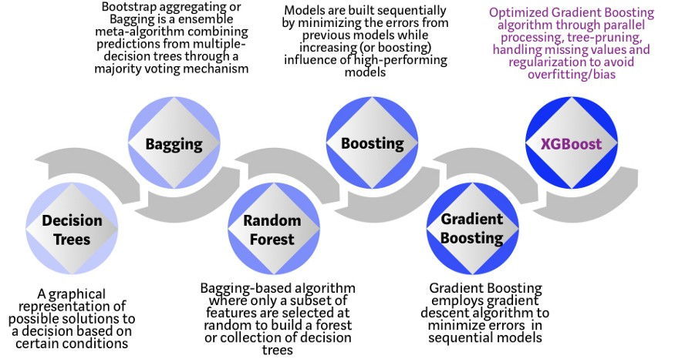
XGBoost is a decision-tree-based ensemble Machine Learning algorithm that uses a gradient boosting framework.

Slide 3
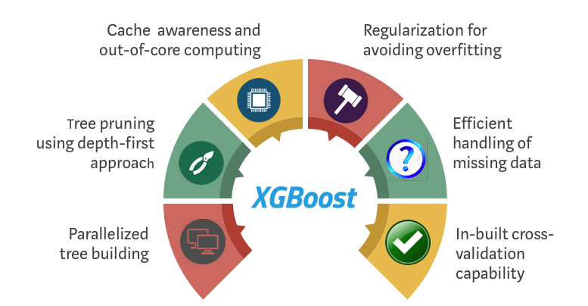
Why XGBoost?
XGBoost and Gradient Boosting Machines (GBMs) are both ensemble tree methods that apply the principle of boosting weak learners (CARTs generally) using the gradient descent architecture. However, XGBoost improves upon the base GBM framework through systems optimization and algorithmic enhancements.

Slide 4
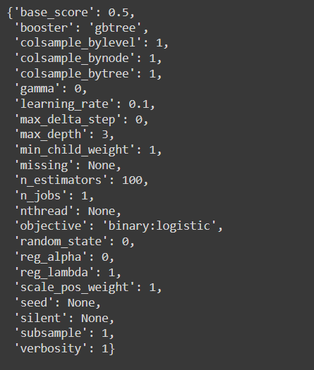

XGBoost Parameters
Default Parameters
Parameter Tuning

